Slide 1


Slide 2
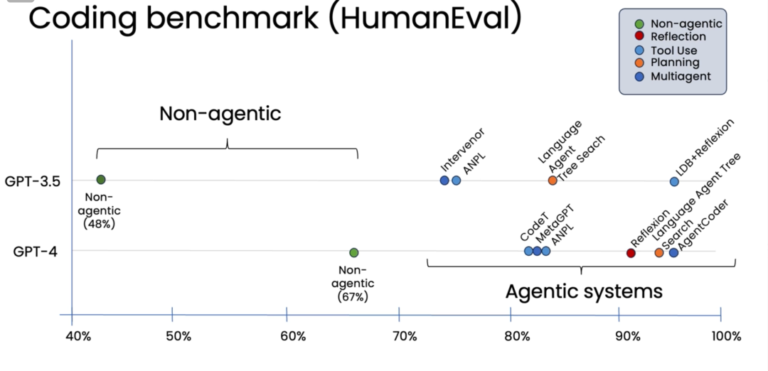
Compare Model Performance with and without Agents

Slide 3
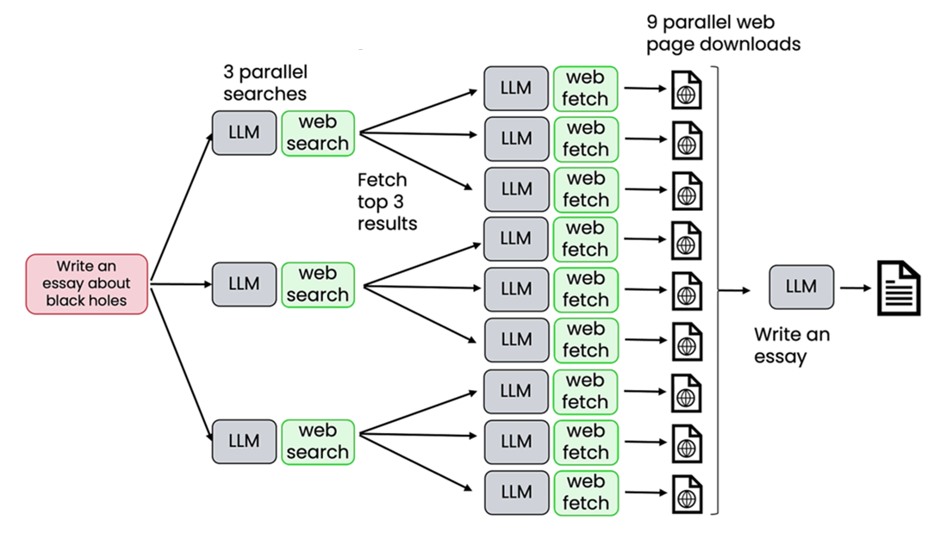
Parallelization for Speed

Slide 4
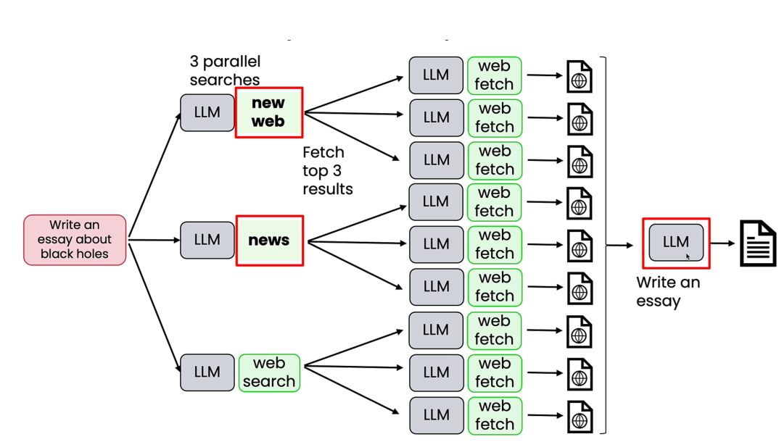
Modular: Add/Swap out components

